Slide 1
Securing a Small Business Network
Team Members
Ahmed Shaban Abo-Elfaddle Malak Emad Mohamed Ahmed Ashraf Mokhtar Hassan Hesham Eldein Hana Ashraf Yahya Yoliana Adel Isaac

Slide 2
Introduction
Business Scenario:
A small business with 30 employees needs a secure network that supports workstations,
servers, printers, and Wi-Fi access.
The business requires secure access to sensitive data, remote access for employees,
and protection from cyber threats.
Project Goals:
Implement a secure network design.
Ensure network segmentation.
Provide secure access and prevent unauthorized access.

Slide 3
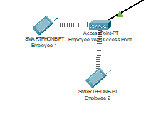
Network Design Overview
Design Strategy:
The network is divided into two primary zones: Administrative and Business, Servers, Guests
Key devices include routers, switches, workstations, printers, and wireless access points.
Wireless Network: Wi-Fi access for employees and a secure guest network.

Slide 4
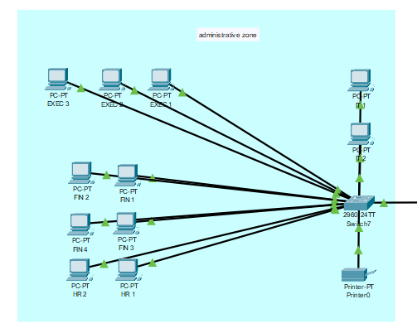
Administrative Zone: For executives, finance, and HR departments.

Slide 5
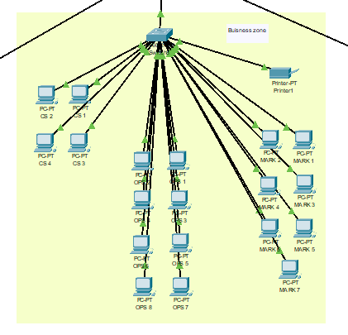
Business Zone: For customer service, marketing, and operations.

Slide 6
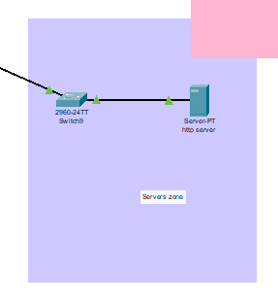
Servers Zone: Isolated from the guest and employee zones to protect sensitive data.

Slide 7
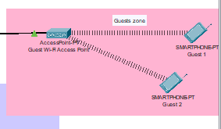
Guests Zone: Provides internet access to guest devices

Slide 8
Core Network Infrastructure
Router:
Connected to the external cloud (Internet).
Routes traffic between internal zones and the outside network.
Core Switch:
Acts as the network backbone, interconnecting all zones.
Connection to Servers: Dedicated links to the central server hosting services like email
and file storage.

Slide 9
IP Addressing
Subnetting:
Each zone will have its own subnet to ensure organized addressing and separation
of network traffic.
Example:
Administrative subnet: 192.168.20.0/24.
Business subnet: 192.168.30.0/24, 192.168.40.0/24, 192.168.50.0/24.
Server subnet: 192.168.60.0/24.
Guest subnet: 192.168.100.0/24.
Benefits:
Better traffic management.
Enhanced security through segmentation.

Slide 10
Security Measures
ACL Rules: An extended ACL was used to permit DHCP IP assignment from the router while
blocking external network access to the internal network, except for the business’s website.
Network Segmentation: The network was segmented to allow communication within the same
or related departments, with cross-department communication managed through Layer 3 routing.
VPN Setup: VPN access is restricted to IT employees, allowing secure remote troubleshooting
on routers and switches.

Slide 11
Conclusion
Summary of the Design:
Highlight the main features: network segmentation, security measures, remote access,
and IP addressing.
Project Success:
The design ensures secure access, data protection, and easy scalability for the business.

Slide 12


